Slide 1
Uncontrolled copy not subject to amendment
Basic Navigation Using Map and Compass

Slide 2
Basic Navigation Using Map and Compass
Learning Outcome 4:
Know land navigation methods

Slide 3
Roamer Scale

Slide 4
Pinpointing position

Slide 5
Distance travelled

Slide 6
Dog Leg Detours

Slide 7
Spot and Line Transit

Slide 8
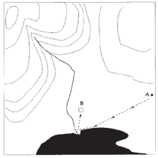
Attack Points
Aim for an easily identifiable feature close to your target

Slide 9
Using Attack Points

Slide 10
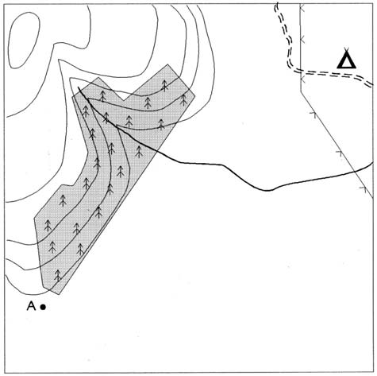
Handrailing
Following the linear features

Slide 11
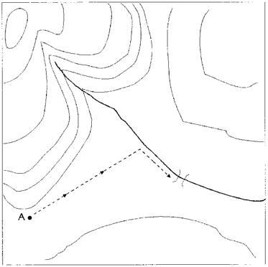
Aiming Off
Aim to one side of the bridge so that you know which way
to turn on reaching the river

Slide 12
Aiming off
Another example

Slide 13
Boxing Round

Slide 14
Mapping Spiral

Slide 15
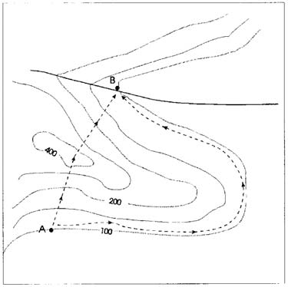
Contouring
Take care when deciding the best route to follow

Slide 16
Outriggers

Slide 17
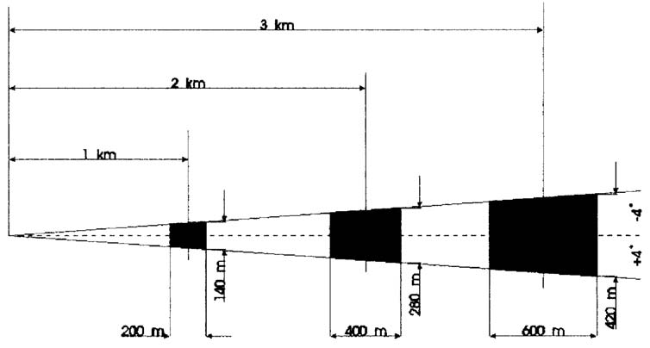
Errors
The area of uncertainty becomes large after only a short distance

Slide 18
Degree error

Slide 19
Calculating timing

Slide 20
Speed and distance travelled

